Slide 1
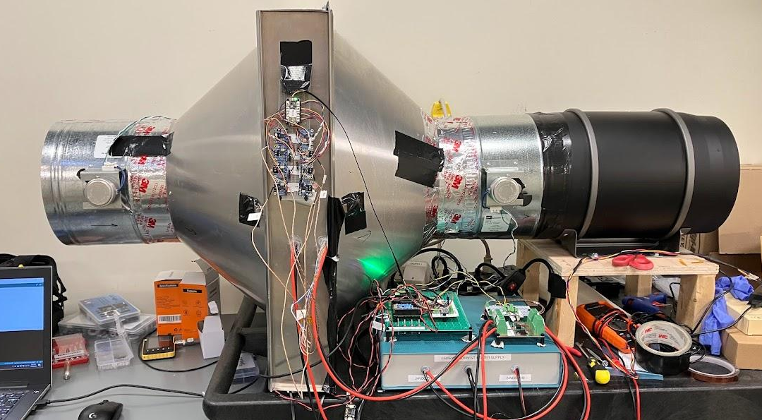
Project Epiphyte
Lessons Learned
Advice for Next Builder

Slide 2
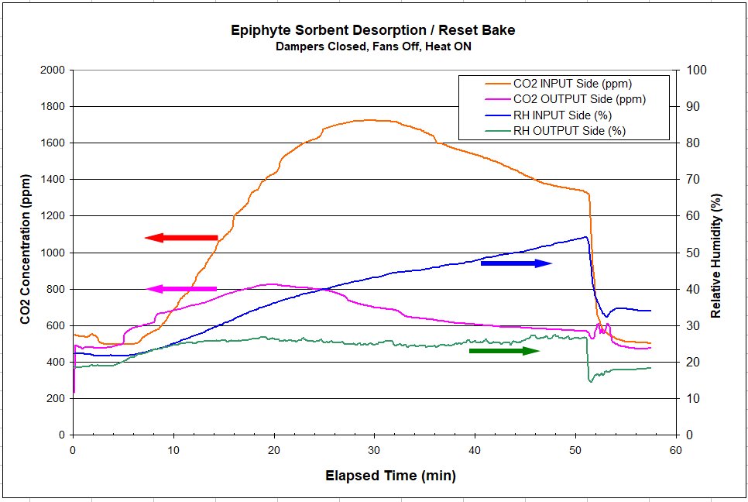
Accomplishment: We captured (some) CO2! With a system built by part-time volunteers on a limited budget.

Slide 3
A few suggested improvements and advice

Slide 4
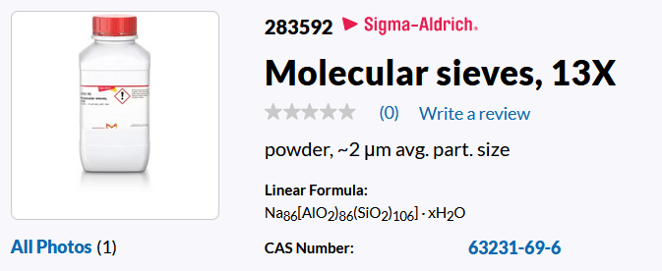
Need Better Sorbent
Zeolite 13X is NOT ideal for capturing CO2
Estimated CO2 captured in a 1-hour cycle: Approx. 300mg

Slide 5
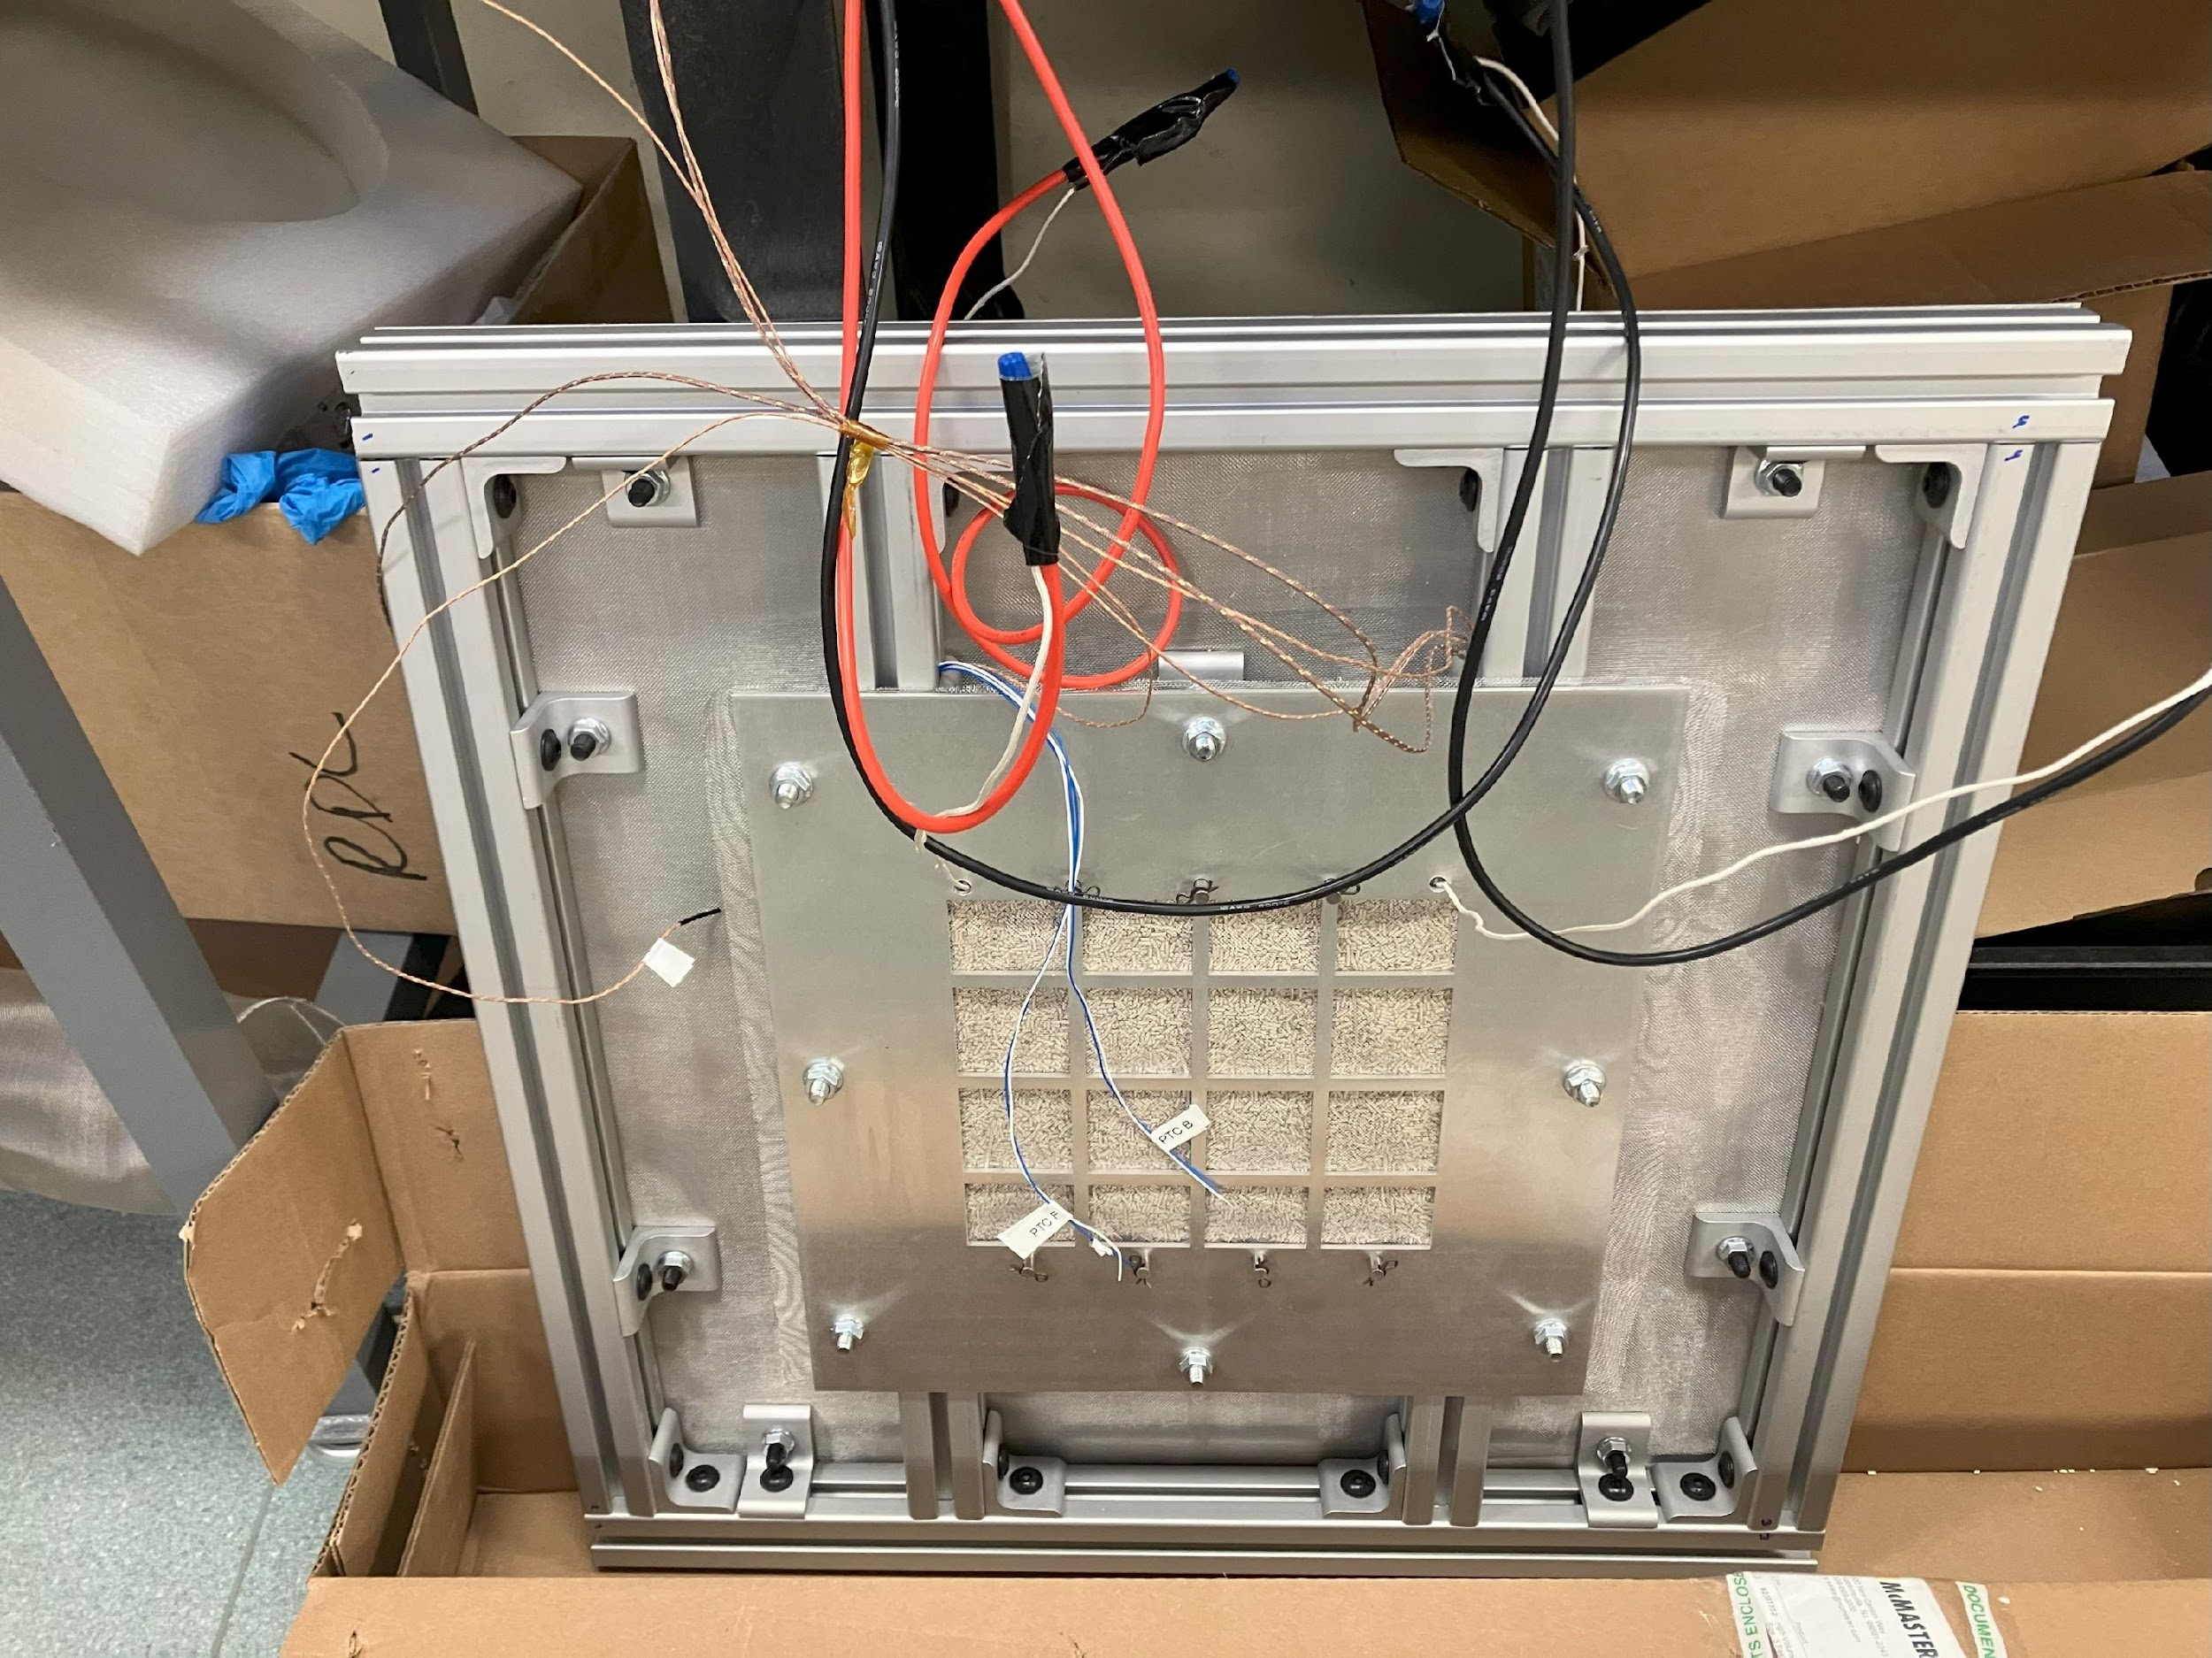
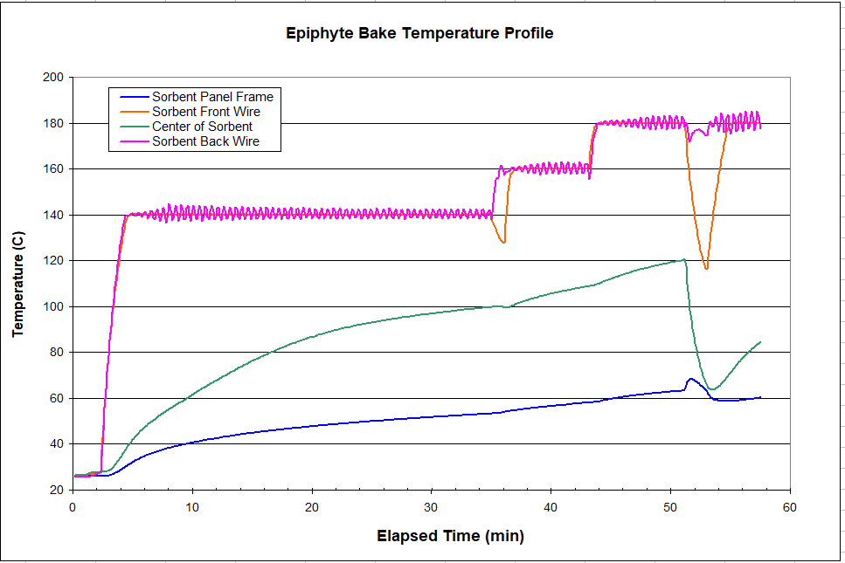
Improve thermal characteristics of sorbent panel
Lots of metal draws heat away from sorbent

Slide 6
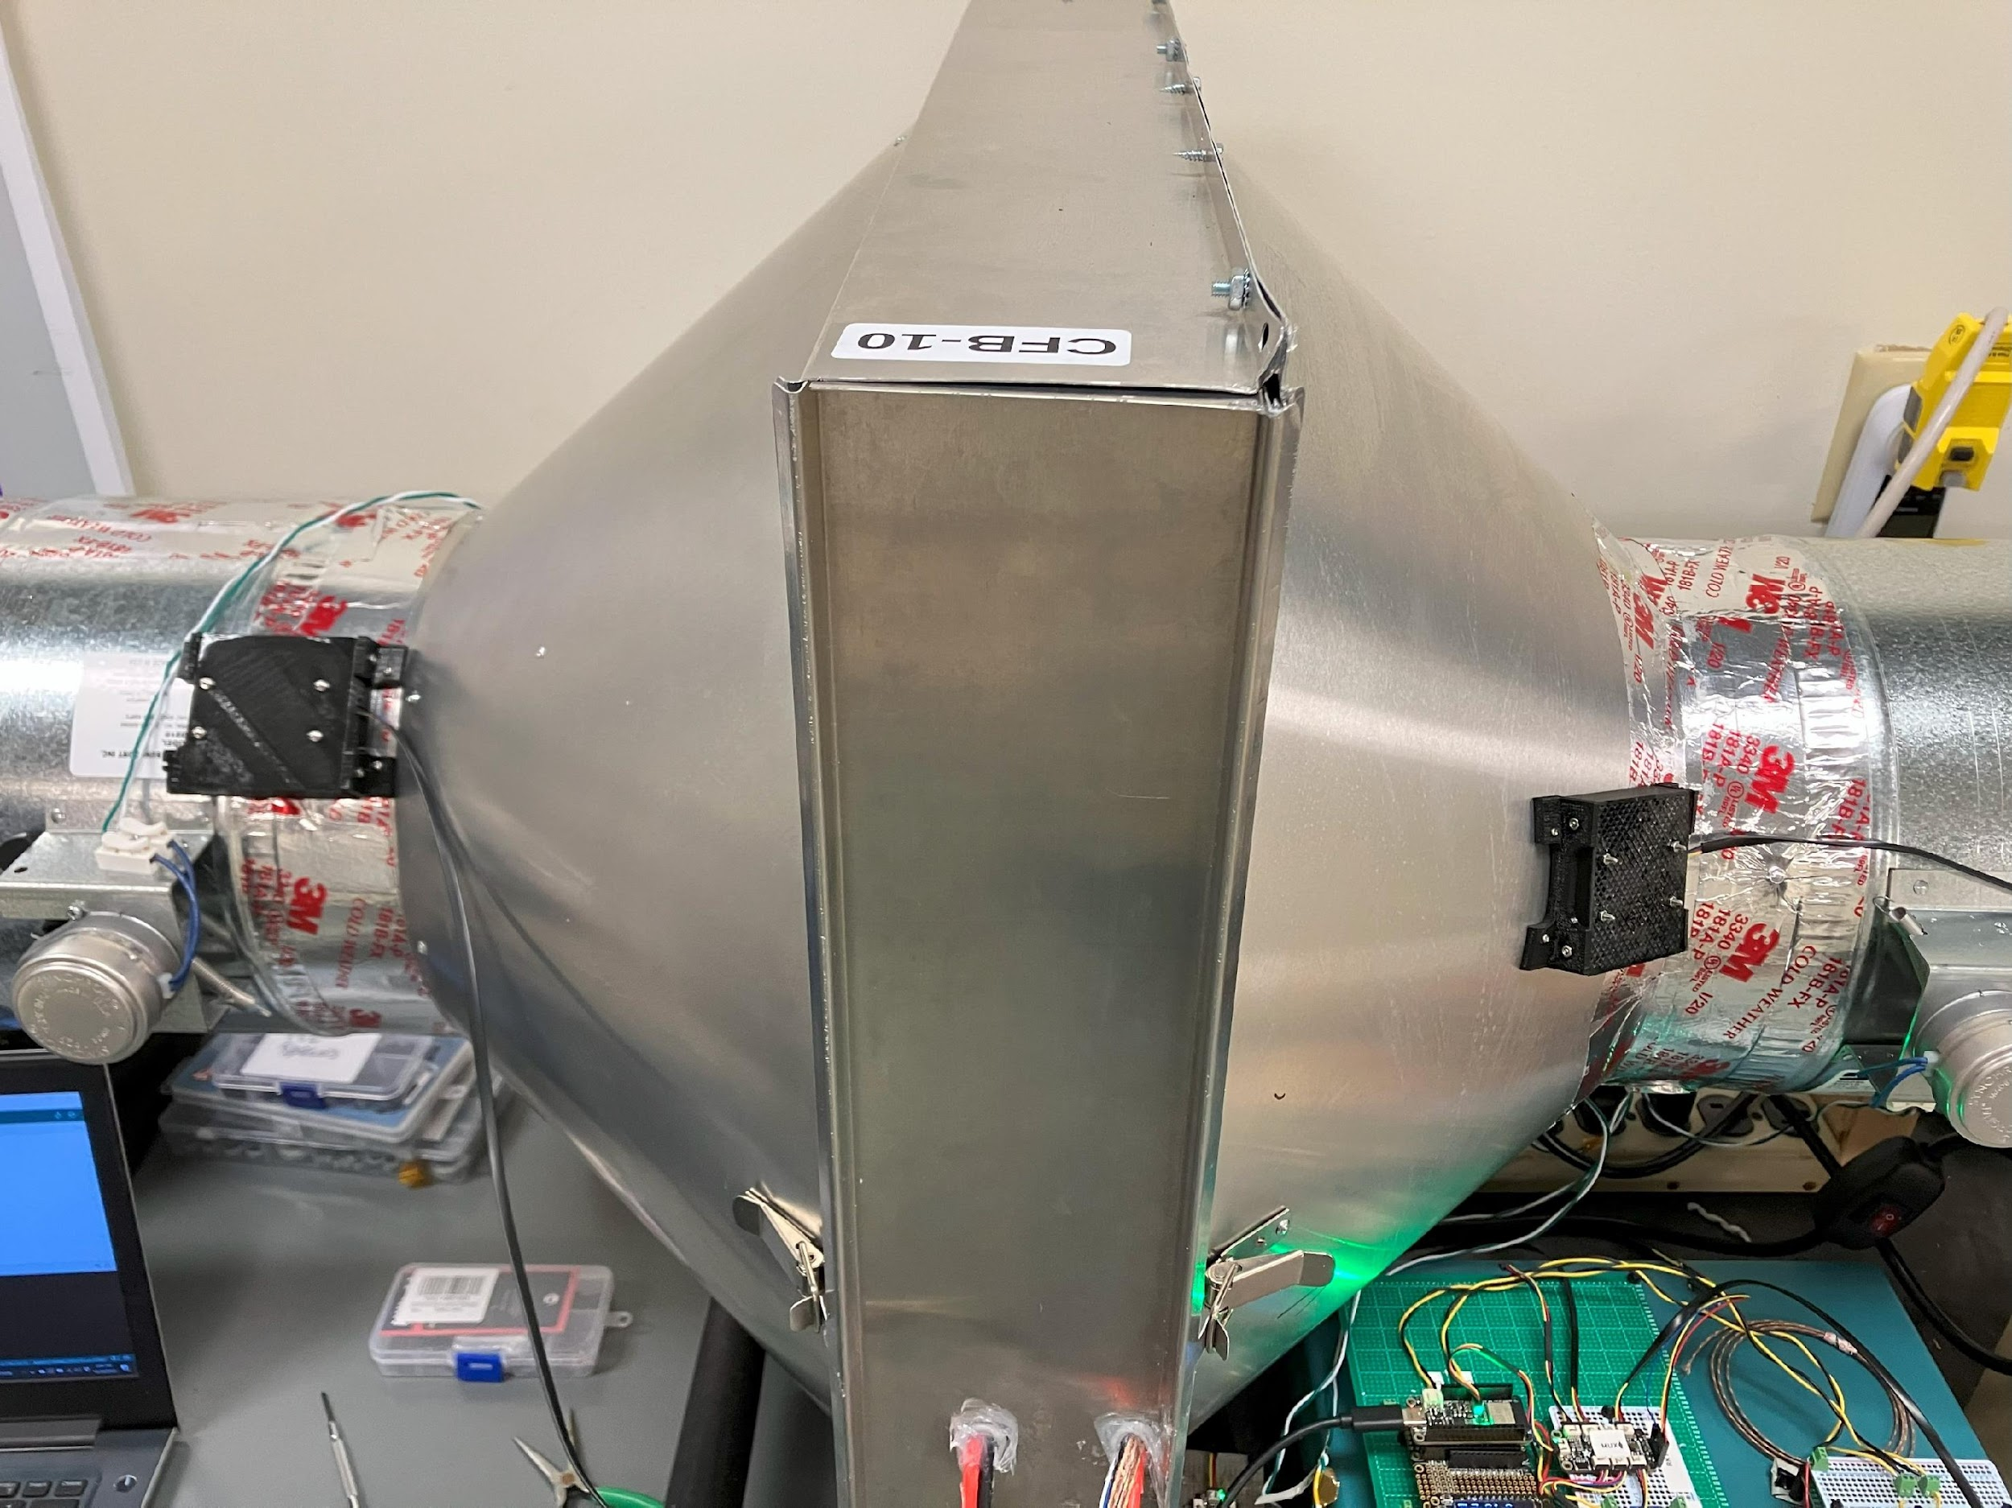
Need tighter box for sorbent chamber
LEAKY!
FLIMSY!

Slide 7
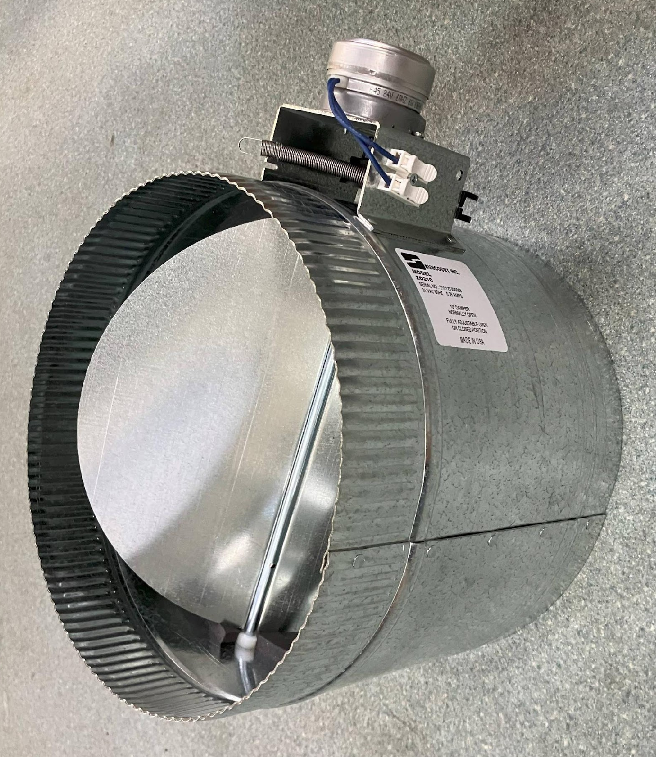
Need vacuum-sealing dampers/valves

Slide 8
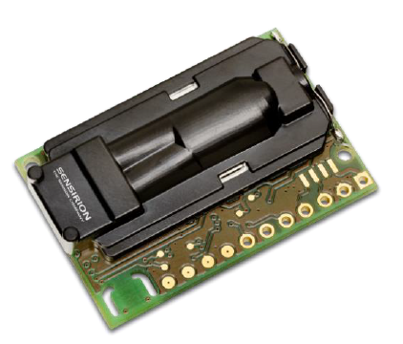
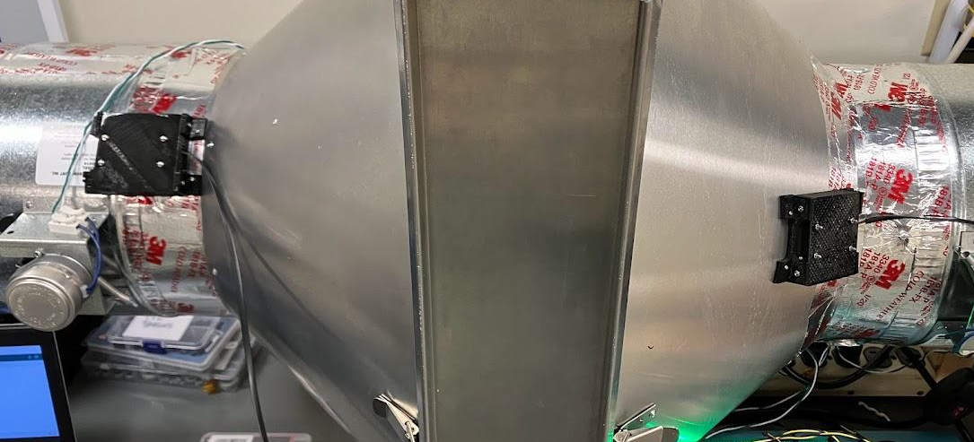
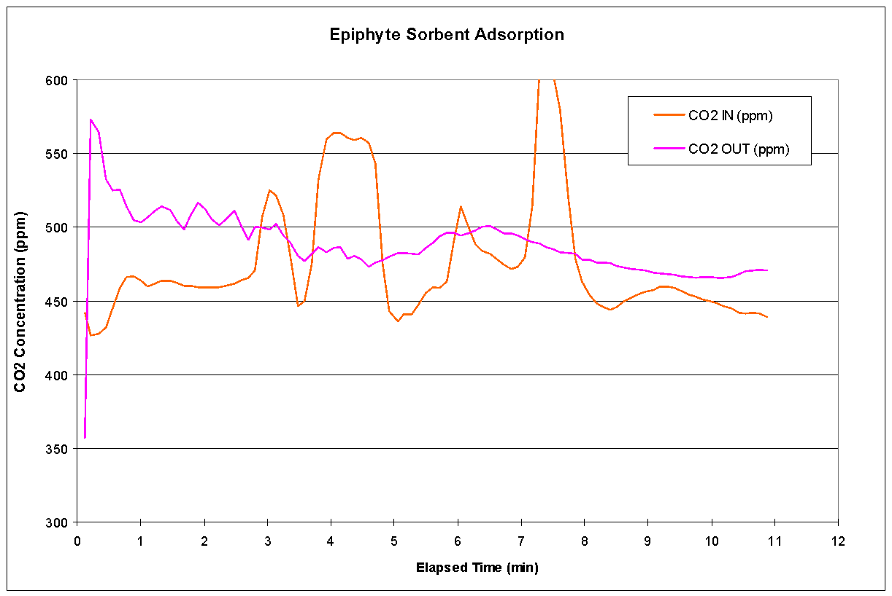
CO2 Sensor Issues (Turbulence, Repeatability)
Need to understand airflow and placement

Slide 9
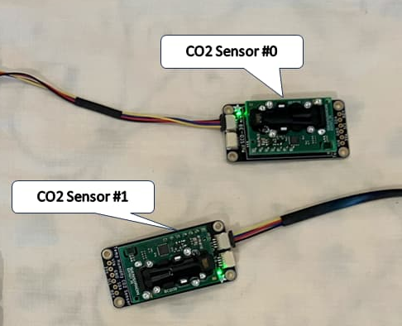
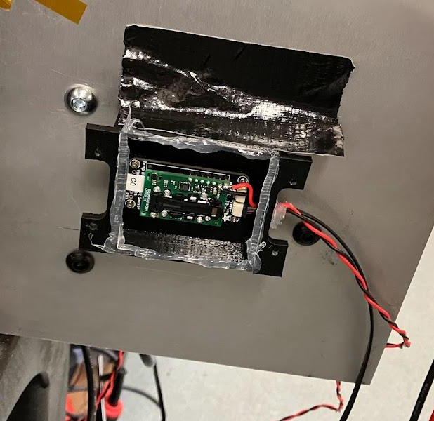
Pay Attention to Electronics e.g. CO2 Sensors
Original wiring: Adafruit Stemma QT Cables.
Glitchy and missing data!
Improved wiring: Separate power wires, bypass voltage regulator on breakout board

